Slide 1
Classifying Different Cancer Types Based on Transcriptomics Data Using Machine Learning Algorithms
By
Eunice Olorunshola
Presented to the Committee
Committee Chair: Murray Patterson, PhD
Committee Member: Alex Zelikovsky, PhD
Committee Member: Jonathan Shihao Ji, PhD
Georgia State University
Notes:
Good Afternoon members of the thesis committee, I would like to express my sincere appreciation for your presence here today. My name is Eunice Olorunshola and I have been working on my master’s thesis under the guidance of Dr. Murray Patterson The title of my thesis is Classifying Different Cancer types based on transcriptomics data using machine learning Algorithms.

Slide 2
Table of Contents
Introduction | 03
Motivation | 04
Literature Review | 05
Datasets | 06
Implementation | 07
Results | 13
Discussion | 15
Conclusion and Future Works | 17

Slide 3
Introduction
Cancers development
Complexity of cancer initiation and progression.
Disrupts regulations of cell growths
Affects protein activities
Genetic Mutation role
Significant genes with upregulation or downregulation
Gene Expression Analysis
Utilizing RNA-Sequencing to examine transcriptomic profiles.
Leveraging machine learning algorithms
Significance of functional changes:
Critical insights for disease prognosis
Personalized treatment strategies
Early diagnosis
Notes:
Cancer, as we know, is a complex process marked by the disruption of cellular regulations, impacting cell growth and protein activities. Understanding these processes is crucial in devising effective treatment strategies.
Genetic mutations play a pivotal role in cancer. We'll delve into the significance of genes experiencing upregulation or downregulation, exploring their impact on cancer initiation and progression
To unravel the difficulties within cancer development, my research applied advanced techniques such as RNA-Sequencing for gene expression analysis. This allows us to examine transcriptomic profiles with a high level of precision.
In addition to traditional methods, my study leverages machine learning algorithms. This integration enhances our ability to make sense of complex data, providing valuable insights into the intricate world of cancer at the molecular level.
The functional changes identified through this approach are not merely academic; they hold critical implications for disease prognosis, the development of personalized treatment strategies, and even early diagnosis.
Now that we have set the stage for the complexity of cancer development and the methodologies employed, let's move on to the specifics of my research approach, particularly the utilization of RNA-Sequencing and machine learning in analyzing transcriptomic profiles.

Slide 4
Motivation
Address the increasing challenge of cancer through genomic insights
To use RNA-Sequencing
Use read from blood tissue cancer samples
Transcriptomic profiles
Identifying differentially expressed genes in RNA-Sequencing data
Apply machine learning algorithms for efficient pattern recognition in large-scale genomic datasets.
Notes:
Now, let's delve into the motivation behind my research. The increasing challenge of cancer has propelled me to explore genomic insights as a means to unravel its complexities and devise more effective strategies
Understanding cancer at the genomic level is crucial. It allows us to identify specific alterations that drive cancer development, paving the way for targeted interventions. My research aims to contribute to this understanding
To achieve this, I’ve applied RNA-Sequencing, a tool that provides a comprehensive view of the transcriptomic landscape. This technology allows us to analyze gene expression patterns with unprecedented detail
I've chosen to use RNA-Sequencing data derived from blood tissue cancer samples. This choice is significant as it offers insights into systemic changes and enables a more understanding of cancer progression
Within this dataset, my research focuses on identifying differentially expressed genes. These genes play a pivotal role in understanding the variations in gene expression associated with cancer development.
Recognizing the vast scale of genomic data, I've incorporated machine learning algorithms. These algorithms efficiently sift through large datasets, allowing us to recognize patterns and glean valuable insights from the complex genomic landscape
By combining genomic insights, RNA-Sequencing, and machine learning, my research aims to contribute to our understanding of cancer development, with the ultimate goal of improving diagnostic accuracy, prognosis, and the development of personalized treatment strategies

Slide 5
Literature Review
Zhang YH, Huang T, Chen L, Xu Y, Hu Y, Hu LD, Cai Y, Kong X. Identifying and analyzing different cancer subtypes using RNA-seq data of blood platelets. Oncotarget. 2017 Sep 15;8(50):87494-87511. doi: 10.18632/oncotarget.
Notes:
This paper focuses on using RNA-seq data from blood platelets to identify and analyze various cancer subtypes.
2. Significance of the Study:
Liquid Biopsy Advantages:
Liquid biopsy offers a noninvasive approach, enhancing accuracy and reducing costs in cancer detection.
Machine Learning in Cancer Detection:
Applying machine learning to liquid biopsy data presents potential for personalized expression profiling and accurate cancer detection.
3. Overview of Relevant Literature:
Previous Studies:
Several studies explore machine learning in cancer detection; however, limited focus on blood platelet RNA-seq data.
Quantitative Gene Expression Profiles:
Quantitative gene expression profiles serve as a basis for analysis and feature selection in cancer subtype detection.
4. Context Establishment:
Role of RNA-seq in Cancer Research:
RNA-seq data from blood platelets is crucial for understanding diverse cancer subtypes.
mRMR Feature Selection Method:
The mRMR method is reliable for feature selection, crucial for solving complex biological problems.
5. Identify Knowledge Gaps:
Limited Studies on Blood Platelets:
There's a gap in research focusing on RNA-seq data from blood platelets for cancer subtype identification.
Need for Biomarkers:
Identifying optimal blood biomarkers is necessary for improving the detection of various cancer subtypes.
6. Advancement of Knowledge:
Novelty in Biomarker Identification:
The paper contributes by proposing a method to identify optimal blood biomarkers, enhancing the distinction between cancer subtypes.
Performance Evaluation:
The use of machine learning and feature selection methods improves accuracy in cancer subtype detection, potentially surpassing traditional methods.
1. Introduction:
Opening Statement:
Both studies address the challenge in cancer detection, emphasizing innovative approaches.
Study Focus:
Your study explores RNA-seq data for classification, while the referenced paper focuses on cancer subtype identification.
2. Significance of the Study:
Liquid Biopsy Advantages:
Shared recognition of the significance of liquid biopsy for accuracy and cost reduction.
Machine Learning in Cancer Detection:
Both studies leverage machine learning to enhance cancer detection accuracy.
3. Overview of Relevant Literature:
Previous Studies:
Both studies build upon existing research, offering unique contributions.
Quantitative Gene Expression Profiles:
Reliance on quantitative gene expression profiles is a common foundation in both studies.
4. Context Establishment:
Role of RNA-seq in Cancer Research:
Mutual recognition of the crucial role of RNA-seq data in cancer research.
mRMR Feature Selection Method:
Application of the mRMR method underscores its importance in solving biological problems in both studies.
5. Identify Knowledge Gaps:
Limited Studies on Blood Platelets:
Shared observation of a research gap related to blood platelets.
Need for Biomarkers:
Recognition of the need for optimal blood biomarkers is a common theme.
6. Advancement of Knowledge:
Novelty in Biomarker Identification:
Both studies contribute by proposing novel approaches for biomarker identification.
Performance Evaluation:
Shared interest in improving accuracy through machine learning, with a focus on classification performance.
Introduction and Importance of Cancer Detection:
The introduction of the paper highlights the importance of cancer detection for early prevention and effective treatment. Discuss how the paper aligns with this goal and the relevance of early cancer detection in your study.
Liquid Biopsy as a Noninvasive Detection Approach:
The paper proposes liquid biopsy as a noninvasive detection approach. Discuss the significance of liquid biopsy in cancer research and its potential impact on the accuracy and cost-effectiveness of detection.
Scope of Cancer Subtypes:
The paper analyzes data from six different cancer subtypes, including breast cancer, colorectal cancer, glioblastoma, hepatobiliary cancer, lung cancer, and pancreatic cancer. Discuss how the inclusion of these specific cancer subtypes aligns with or differs from the scope of your study.
Application of Machine Learning Algorithms:
The paper applies reliable machine learning algorithms to analyze gene expression profiles. Discuss the choice of machine learning algorithms and how they contribute to the understanding of cancer subtypes. Compare this with the algorithms used in your study.
Feature Selection Using mRMR Method:
The paper employs the mRMR method for feature selection. Discuss the importance of feature selection in genomics research and how this method contributes to the identification of important biomarkers.
Utilization of Support Vector Machine (SVM):
Discuss the paper's choice of SVM as the classification algorithm. How does the utilization of SVM contribute to the accuracy and reliability of cancer subtype detection? Compare this with your study's choice of classification algorithms.
Cross-validation for Model Evaluation:
Both studies use ten-fold cross-validation for evaluating the performance of the classification model. Discuss the significance of this cross-validation method in ensuring robust and reliable results in genomics research.
Performance Metrics - Accuracy, Sensitivity, and Specificity:
The paper employs accuracy, sensitivity, and specificity as performance metrics. Discuss how these metrics provide a comprehensive assessment of the model's performance in detecting cancer subtypes.
Computational Considerations and Limitations:
The paper mentions computational limitations and the use of ten-fold cross-validation over jackknife test. Discuss the computational considerations in genomics research and any trade-offs made in terms of computation time and accuracy in your study.
Relevance and Contribution to Your Study:
Summarize how the insights from this paper influenced your choice and approach in your study. Highlight the specific aspects of the paper that are directly relevant to your research objectives.

Slide 6
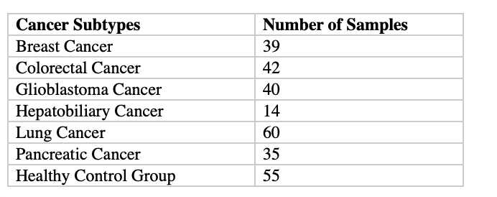
Datasets
Gene Expression Omnibus: accession number GSE68086
Zhang YH, Huang T, Chen L, Xu Y, Hu Y, Hu LD, Cai Y, Kong X. Identifying and analyzing different cancer subtypes using RNA-seq data of blood platelets. Oncotarget. 2017
Dataset Origin
Liquid biopsy blood tissue samples
RNA Sequencing Data: Tumor – Educated Platelets
Notes:
Now lets go into details of my research the datasets. The he primary dataset for my study originates from a notable source: Zhang YH et al.'s work published in 'Oncotarget' in 2017.
The dataset, with Gene Expression Omnibus accession number GSE68086, is particularly unique. It comprises RNA-sequencing data of blood platelets, focusing on a variety of cancer subtypes.
all samples are derived from liquid biopsy blood tissue. This approach provides a unique perspective, allowing us to capture systemic changes associated with these cancer subtypes.
The RNA-sequencing data we analyze specifically focuses on a aspect—Tumor Educated Platelets. These platelets carry information reflective of the tumor environment, offering a dynamic snapshot of cancer-related changes
The significance of this dataset lies in its diversity and the unique nature of the samples. Analyzing the RNA-sequencing data from Tumor Educated Platelets provides a window into the molecular intricacies of various cancer subtypes

Slide 7
Data Preparation (FastQ)
Initial Dataset : 285 samples
High-quality Successful Samples : 229
Single-end reads
Data Retrieval Challenges: 56 sample was not successfully retrieved from the gene expression Omnibus database.
Notes:
Data preparation
Initially we started with a dataset comprising 285 samples—each representing a unique perspective on the molecular landscape of cancer.”
we identified 229 high-quality successful samples.
The data we work with is in the form of single-end reads. This format is particularly suited to our study, allowing us to capture valuable information efficiently
However 56 samples encountered difficulties during the retrieval process from the Gene Expression Omnibus (GEO) database. Despite this challenge, 229 samples allowed us to move forward.
Having successfully navigated the challenges in data retrieval and ensuring the quality of our dataset. Lets move on to the next phas

Slide 8
STAR Aligner
STAR(Spliced Transcripts Alignment to a Reference) Aligner is an RNA-sequencing aligner for mapping reads to a reference genome
Advantages – Speed, Sensitivity, Memory efficiency and Parallelization
Alignment Accuracy : High Accuracy in identifying known and novel splice junctions.
Notes:
Moving into the flow of the methodology, I would like to highlight the pivotal role of the STAR Aligner in our RNA-seqencing analysis. STAR stands for 'Spliced Transcripts Alignment to a Reference.
The STAR Aligner is a specialized tool designed for mapping RNA-seq reads to a reference genome. This step is crucial in our analysis as it forms the foundation for understanding the transcriptomic landscape within our curated samples
Why did we choose STAR?
This aligner offers several advantages, making it a robust choice for our study. These advantages include speed, sensitivity, memory efficiency, and the ability for parallelization.
Speed matters especially when working with large-scale genomic datasts. STAR efficiency allow for a timely analysis allowing us to process a significant amount of data with precision.
One of the notable features of STAR is its high accuracy in identifying both known and novel splice junctions. This aligner plays a crucial role in identifying complex patterns in the data.

Slide 9
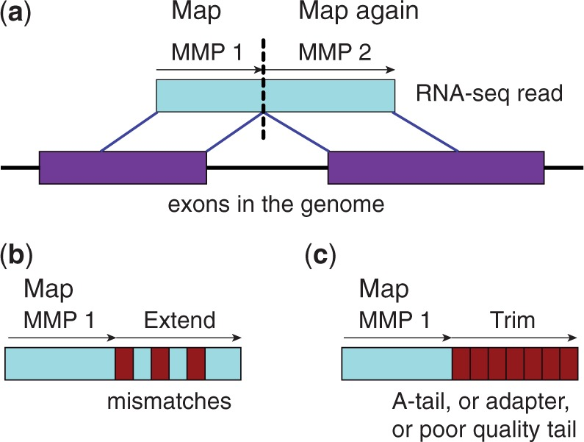
MMP(Maximal Mappable Prefix)
Dobin A, Davis CA, Schlesinger F, Drenkow J, Zaleski C, Jha S, Batut P, Chaisson M, Gingeras TR. STAR: ultrafast universal RNA-seq aligner. Bioinformatics. 2013 Jan.
Notes:
In the context of our study, MMP plays a crucial role in unraveling the difficulties of gene expression in our RNA sequencing data

Slide 10
featureCounts for Gene Expression
Subread package
Tool for counting mapped reads
Handles paired-end and single-end reads
Counts at gene and exon levels
Assigns reads to multiple features.
Notes:
FeatureCounts, a critical tool in our gene expression analysis. FeatureCounts, part of the Subread package, serves as our means of quantifying mapped reads and extracting valuable insights from our RNA-sequencing data.
This package provides us with a robust set of tools, allowing for accurate and efficient analysis of mapped reads.
FeatureCounts is a tool specifically crafted for counting mapped reads. This step is essential in our analysis as it enables us to quantify the expression levels of genes and exons within the dataset.
It seamlessly handles both paired-end and single-end reads, accommodating the diversity in our RNA-sequencing data and making sure of accurate counts across different read types
It also generates counts at both the gene and exon levels. This feature allows us to dissect gene expression patterns with precision, capturing nuances in expression across different genomic regions
Its ability to assign reads to multiple features. In the complex dataset, this capability becomes invaluable, especially in scenarios where reads align to overlapping genomic features.

Slide 11
Differential Expression Analysis
DESEq2 package
- Effective normalization of RNA-Sequencing count data
Identify genes with significant expression changes
Focused on Log2 fold change and adjusted p-values
Notes:
Differential Expression analysis step is important in identifying genes with significant expression changes across different conditions.
The tool of choice for this analysis is the DESeq2 package
DESeq2 is a package mainly designed for the effective normalization of RNA-Sequencing count data. Normalization is important to make sure that our comparisons reflect true biological differences rather than artifacts introduced during data processing
The effectiveness of DESeq2 lies in its ability to address variations in sequencing depth and other factors. This normalization step is essential for achieving reliable and accurate results in our differential expression analysis.
DESeq2 facilitates the identification of genes exhibiting significant expression changes. This step is critical for unraveling the molecular landscape of cancer subtypes and pinpointing key genes associated with these variations
In our analysis we focus on Log2 fold change as a key metric. This metric provides a clear and interpretable measure of the magnitude of gene expression differences between conditions, offering insights into the biological significance of these changes .
To make sure the reliability of our findings, DESeq2 incorporates adjusted p-values. These values account for multiple testing, helping us control the false discovery rate and identify genes with statistically significant expression changes.
DESeq2 seamlessly integrates with the earlier steps of our analysis, complementing the counts generated by FeatureCounts and building upon the precise alignment achieved with STAR.

Slide 12
Machine Learning Algorithms
Dataset : 16,383 features and 229 samples
Classification tasks : Cancer type and Mutation Subtype.
Model training and Evaluation:
- Seven Classifiers used : SVM, NB, MLP. KNN, RF, LR, and DT.
Notes:
Now lets explore the realm of machine learning and its application in our study.
Machine learning algorithms play a crucial role in leveraging the rich information within our dataset to classify cancer types and mutation subtypes.
Our dataset is robust, consisting of 16,383 features and 229 samples. This information serves as the foundation for our machine learning models, allowing us to extract patterns that may not be apparent through traditional analyses
In our study, we undertake two key classification tasks: predicting cancer types and mutation subtypes. These tasks are inherently complex, and machine learning provides a powerful means of unraveling the intricate relationships within our data.
To accomplish our classification tasks, we employed a diverse set of seven classifiers, each bringing unique strengths to the analysis. The classifiers used include SVM, NB, MLP, KNN, RF, LR, and DT
SVM (Support Vector Machine), NB (Naive Bayes), MLP (Multi-Layer Perceptron), KNN (K-Nearest Neighbors), RF (Random Forest), LR (Logistic Regression), and DT (Decision Tree) constitute our ensemble of classifiers.
The classifiers underwent rigorous training on our dataset, learning the patterns and relationships inherent in the features. This phase is crucial in ensuring the models' ability to generalize and make accurate predictions on new, unseen data
Evaluation is equally crucial. We assess the performance of our models through various metrics, considering factors such as accuracy, precision, recall, and F1 score. This comprehensive evaluation ensures the reliability and generalizability of our machine learning models.
Now that we have explored the utilization of machine learning algorithms in our study, lets uncover the findings and insights gained from these classifers

Slide 13
Results & Visualizations

Slide 14
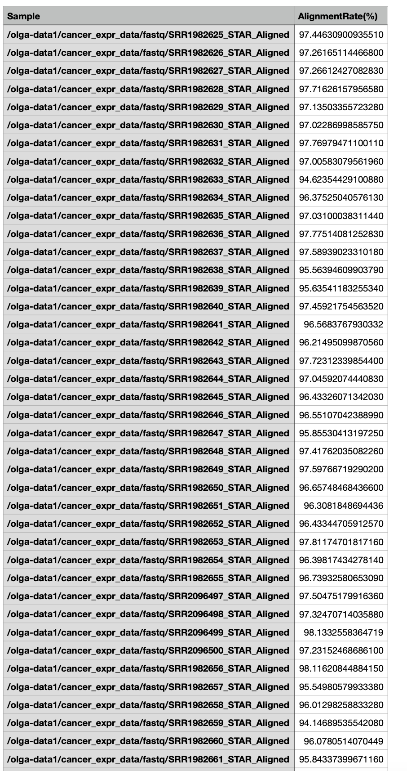
STAR Aligner Results
High Alignment Rate : Average alignment rate of 96.1%
Effective Mapping
Reliable Results
Notes:
High Alignment Rate:
One key highlight is the consistently high alignment rate, averaging an impressive 96.1%.
This indicates the efficiency of the STAR Aligner in mapping our reads to the reference genome.
The success of our study is attributed to the effective mapping achieved by the STAR Aligner.
Discuss how effective mapping is crucial for downstream analyses, ensuring that each read finds its place in the reference genome.
he STAR Aligner has consistently delivered reliable results throughout our study.

Slide 15
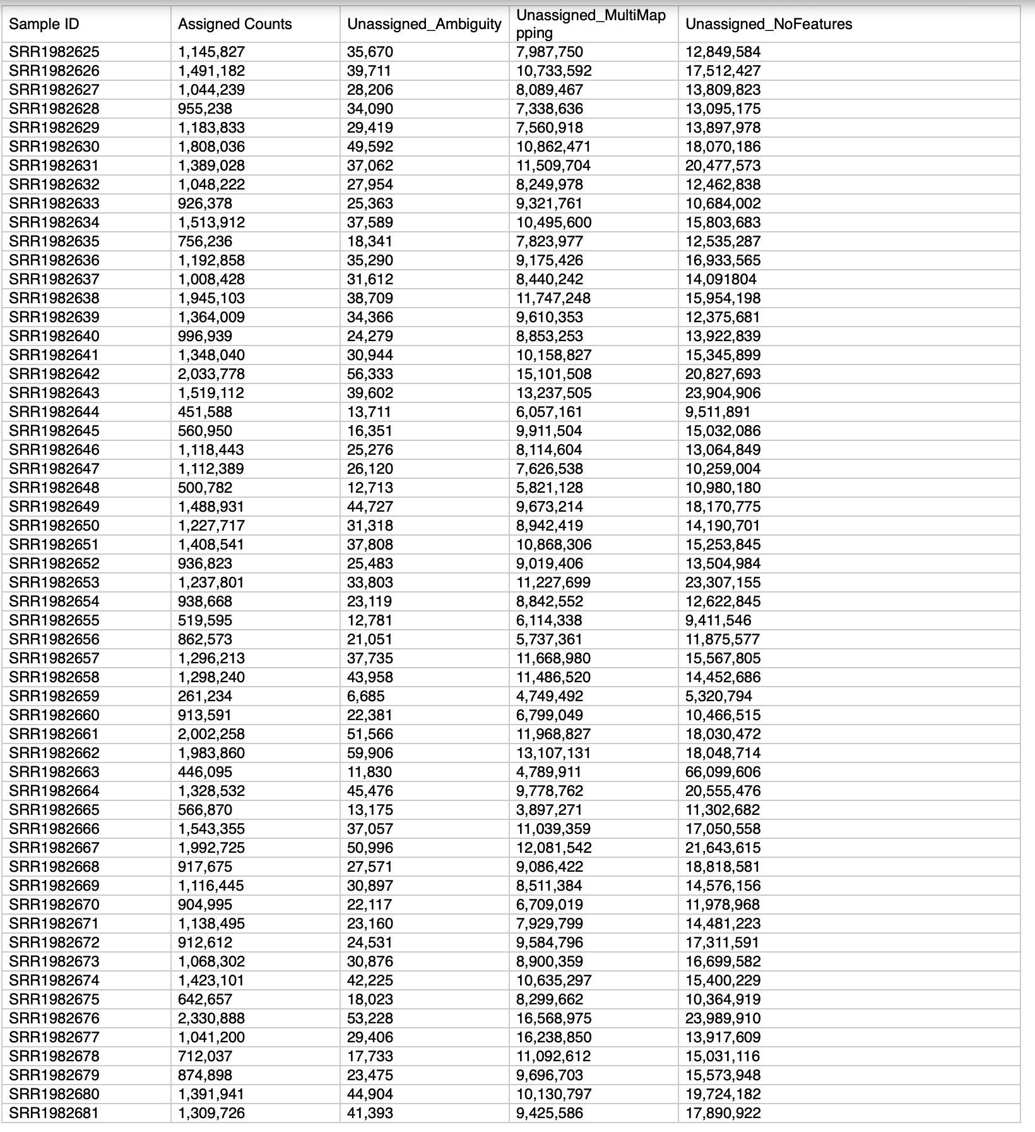
featureCounts Results
Assigned Counts
Average : 106,907,382
Unassigned_Ambiguity
Average : 2,871,389.84
Unassigned_MultiMapping
Average : 86,834,588.696
Unassigned_NoFeatures
Average : 1531655370.87
Notes:
Assigned Counts:
The average assigned count is important, representing the number of reads successfully assigned to genomic features.
A higher average (106,907,382) indicates a robust capture of relevant information in the genomic data, contributing to the overall success of our analysis.
Unassigned_Ambiguity:
The average count for Unassigned_Ambiguity (2,871,389.84) suggests that there are reads with ambiguous mapping.
Addressing ambiguity is essential for refining downstream analysis, ensuring accuracy, and enhancing the reliability of our results.
Unassigned_MultiMapping:
The average count for Unassigned_MultiMapping (86,834,588.696) indicates a significant number of reads mapped to multiple genomic locations.
Coping with multi-mapping is a common challenge, and our analysis pipeline likely includes strategies to handle such instances effectively.
Unassigned_NoFeatures:
The average count for Unassigned_NoFeatures (1,531,655,370.87) highlights reads that couldn't be assigned to any genomic features.
Managing unassigned reads is important, and strategies to handle such cases may include filtering, further investigation, or adjusting downstream analyses accordingly.

Slide 16
Differential Expression Analysis Results & Visualization
Genes with Significant Upregulation and Downregulation
MA Plots
PCA
Volcano Plot and Dispersion Plot
Counts Plot
Histograms and Heatmap
Notes:
explore the outcomes of our differential expression analysis and the visualizations that provide insights into gene expression changes.

Slide 17
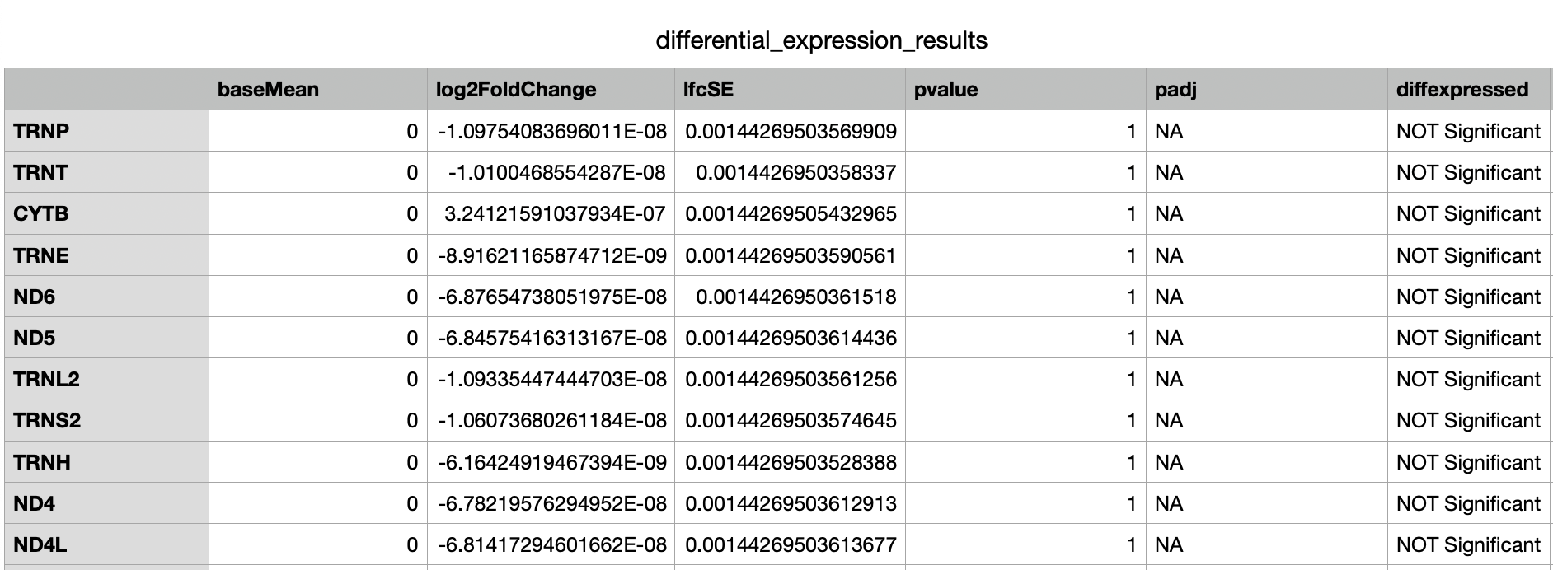
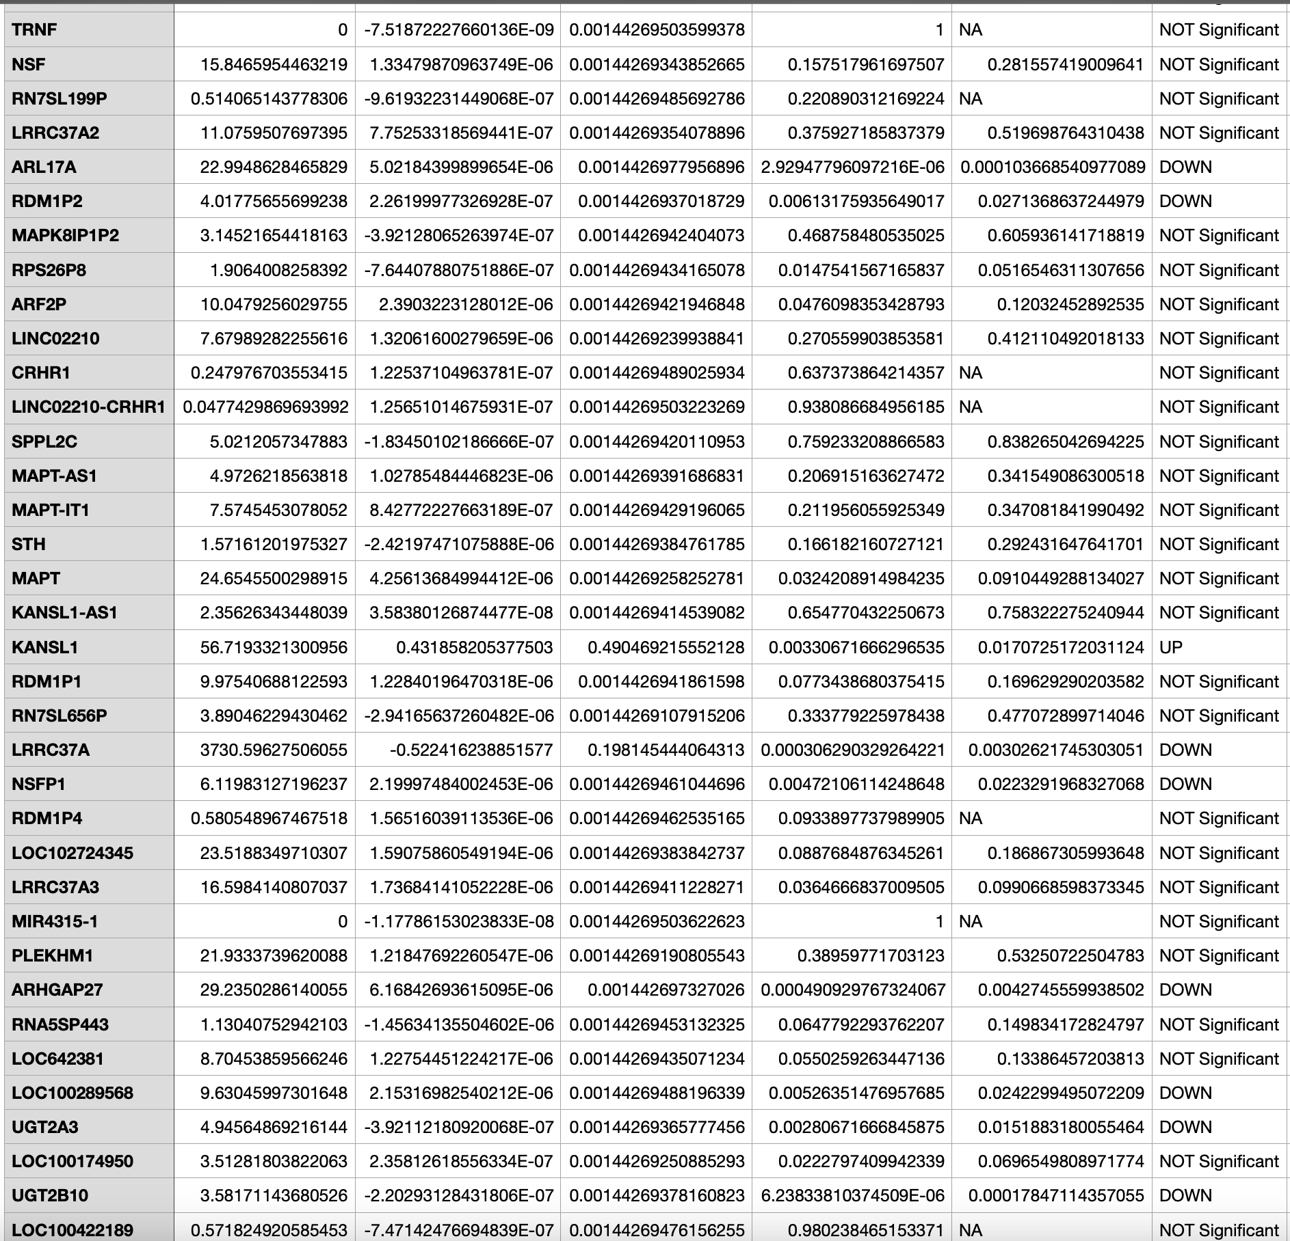
Genes with Significant Upregulation and Downregulation
Notes:
Results of the genes that exhibit significant upregulation and downregulation , allowing for a better insight on their potential roles in the studied conditions
Findings:
Gene KANSL1: had a remarkable upregulation of 56.72 log fold
Allows for a signigicant in the context of cancer subtypes
Gene ARL17A:
Had a significant downregulations
Implications for the biological context
Gene LRRC37A:
A huge upregulation of 3730.60 fold
Gene ARHGAP27
Substantial downregulation
This can influence cancer progress
Gene NSFP1
Significant downregulation
UGT2B10
Significant downregulation
Not all genes show significant changes, a common observation in large-scale genomic studies.
Limitations and Considerations
Sample size and data variability

Slide 18
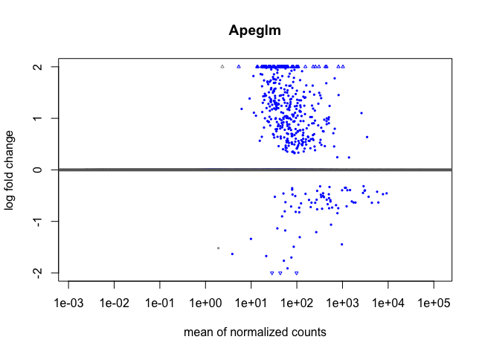
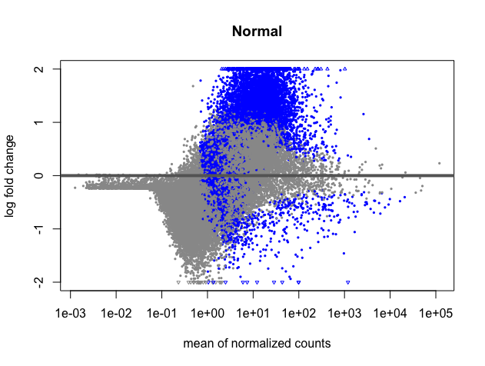
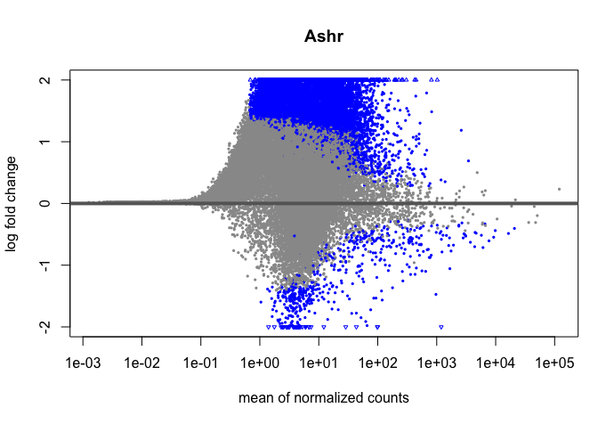
MA Plots
(C)
Apeglm
(a)
Normal
(b)
Ashr
Notes:
MA Plots are commonly used in genomics to visualize the differences between measurements taken in two conditions. The plots also shows the relationship between log fold changes and the average expression
Normal Plot (a)
This plot visually represents the distribution of data points based on their abundance and average abundance.
Observations:
Points are concentrated around the center line, indicating a balanced distribution of measurements.
Ashr Plot (b)
Ashr plot estimates the biological variation in high throughput genomics data particularly RNA-sequencing
Ashr applies a shrinkage approach which shrinks extreme estimates toward more plausible values
Observation : tighter clustering of points especially for genes with low counts
Apelgm
Observatons : improved handling of dispersion
Changes in the spread of points, mainly for genes with differential expression
X: axis (mean of normalized counts) : The X-axis typically represents the mean expression level of a gene across samples. It provides information about the average abundance of a gene in the dataset.
Helps identify genes with consistently high or low expression levels across conditions
Genes with higher mean expression may have more reliable estimates of fold change
Y – axis ( log fold change)
The Y-axis represents the logarithm of the fold change in gene expression between two conditions. It quantifies the magnitude and direction of expression changes
Indicates the direction of differential expression (upregulation or downregulation).
Log transformation helps emphasize both large and small fold changes, making them comparable.

Slide 19
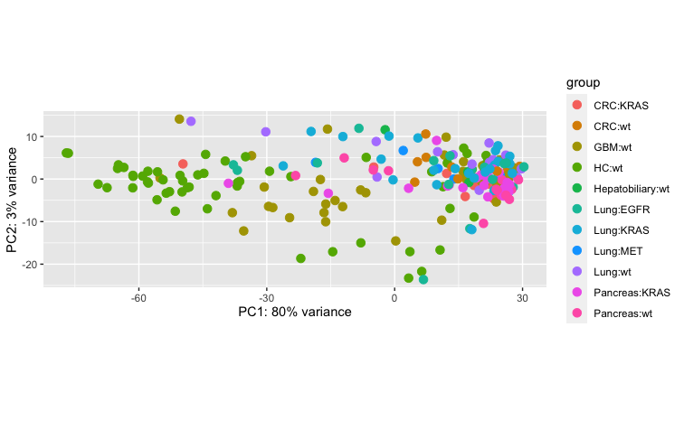
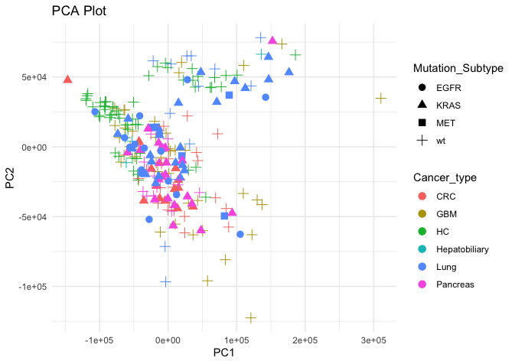
PCA (Principal Component Analysis)
Notes:
Principal Component Analysis (PCA) is a dimensionality reduction technique commonly used in data analysis and statistics. It's particularly valuable in the context of high-dimensional data, such as gene expression data in transcriptomics. Here's an explanation of PCA and its importance in differential expression analysis:
Visualization of Multidimensional Data:
PCA provides a visual summary of the dataset, reducing it to key components.
The scatter plot of samples in reduced dimensions aids in identifying inherent patterns.
2. Key Observations from PCA:
Sample Clustering:
Notable clustering may indicate distinct expression profiles among cancer subtypes.
Overlapping clusters might suggest similarities in gene expression across certain cancers.

Slide 20
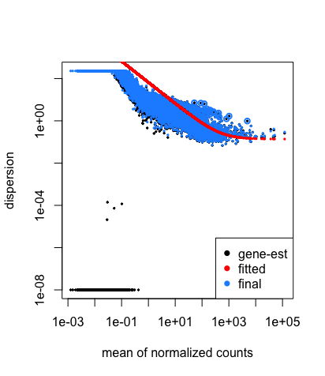
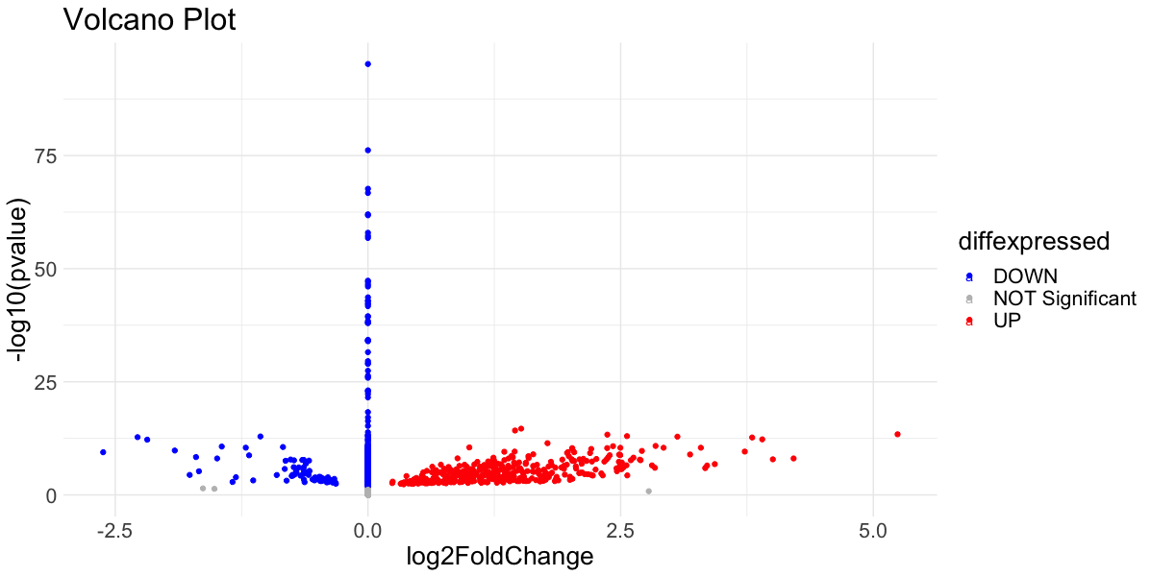
Volcano Plot and Dispersion Plot
Notes:
A volcano plot is a graphical representation used in genomics to visualize the results of differential expression analysis.
X-axis: Represents the fold change in gene expression between two conditions.
Y-axis: Represents the statistical significance of the change, often expressed as -log10(p-value).
Significance Threshold: Identify genes that surpass a significance threshold (e.g., adjusted p-value < 0.05).
Fold Change Threshold: Highlight genes with a considerable fold change (e.g., |log2(fold change)| > 1).
Biological Relevance: Discuss the biological relevance of genes located in the upper regions of the plot (highly significant and with substantial fold change)
A dispersion plot assesses the variability or dispersion of gene expression within conditions.
X-axis: Typically represents the mean expression level of genes.
Y-axis: Represents the measure of dispersion or variability (e.g., standard deviation or variance).
Discussion Points:
Homogeneity of Expression: Evaluate whether genes with similar mean expression levels also exhibit similar levels of dispersion.
Identification of Outliers: Look for genes with unusually high dispersion, as these might indicate biological heterogeneity or technical artifacts.

Slide 21
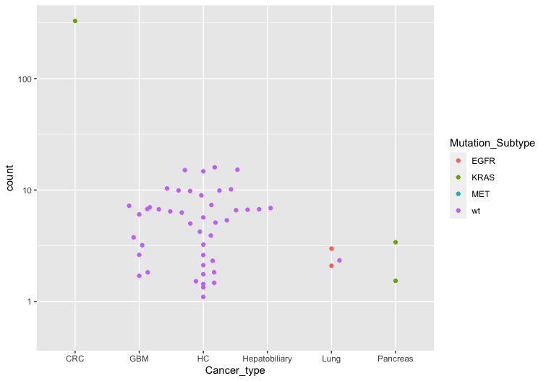
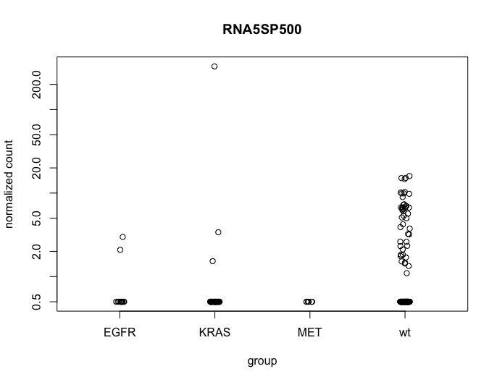
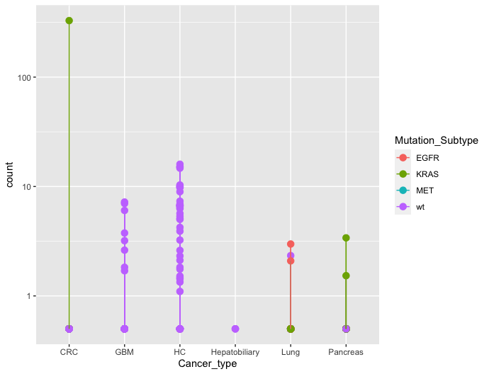
Counts Plot
Normalized counts for a single gene over mutation subtypes group
Normalized counts with lines connecting cell lines
Notes:
Counts Plot: A graphical representation displaying the normalized counts of a single gene across different mutation subtypes or groups.
Normalized Counts: Expression levels of the gene are typically normalized to account for variations in library size and other technical factors.
X-axis: Represents the mutation subtypes or groups.
Y-axis: Depicts the normalized counts or expression levels of the gene.
Expression Patterns: Observe the expression patterns of the gene across mutation subtypes.
Outliers: Identify any samples with unusually high or low expression levels compared to the overall trend.

Slide 22
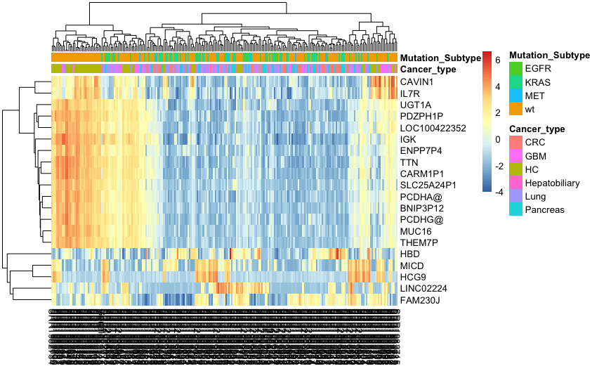
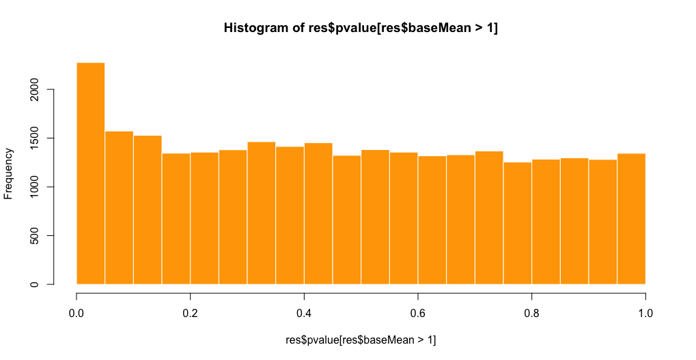
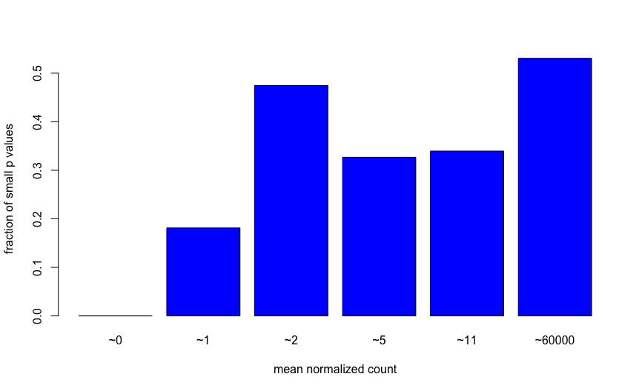
Histograms and Heatmap
20 genes with the highest variance across samples
Histogram of p values for genes with mean normalized count larger than 1
The ratio of small p values for genes binned by mean normalized count
Notes:
Heatmaps of 20 Genes with Highest Variance:
Importance of Gene Variance:
Genes with high variance are influential in discriminating between samples.
The heatmap focuses on these genes, offering insights into their differential expression.
4. Interpretation of Heatmap Patterns:
Gene Expression Patterns:
Observe the heatmap for discernible patterns, like upregulation or downregulation.
Evaluate if specific genes consistently exhibit altered expression across various sample
Histograms Visualization of p Values:
P Values for Genes: A histogram displaying the distribution of p values for genes with a mean normalized count larger than 1.
Ratio of Small P Values: Another histogram presenting the ratio of small p values, binned by mean normalized count.
P Values for Genes:
Statistical Significance: Interpret the histogram to identify patterns in the statistical significance of genes.
Enrichment of Small P Values: Examine whether there is an enrichment of small p values, suggesting potentially significant genes.
Biological Interpretation: Relate significant p values to the biological relevance of the corresponding genes.
Ratio of Small P Values Binned by Mean Normalized Count:
Mean Normalized Count as a Factor: Explore how the ratio of small p values varies across bins of mean normalized count.
Biological Implications: Discuss whether genes with higher mean normalized counts tend to have more significant p values and the biological implications of such trends.
Threshold Selection:
Threshold for Significance: If applicable, discuss the chosen threshold for considering p values as significant.
Biological Context: Relate the threshold to the biological context and the study's objectives.
Biological Interpretation:
Functional Categories: Explore whether genes with small p values are enriched in specific functional categories or pathways.
Biological Processes: Discuss how the observed p value distribution aligns with known biological processes or functions.

Slide 23
Machine Learning Results and Visualization
Model training results on both classification.

Slide 24
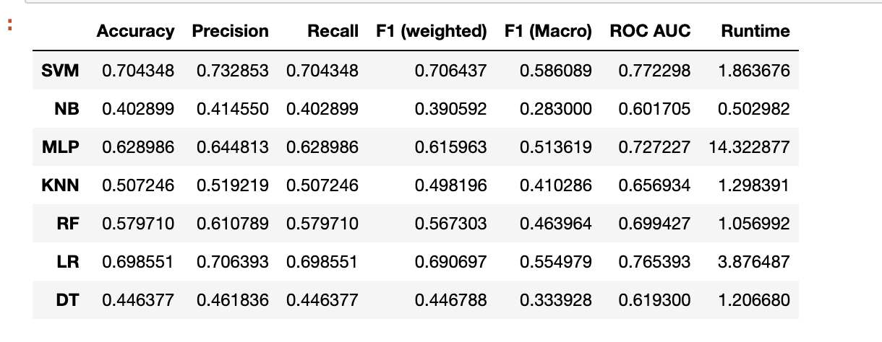
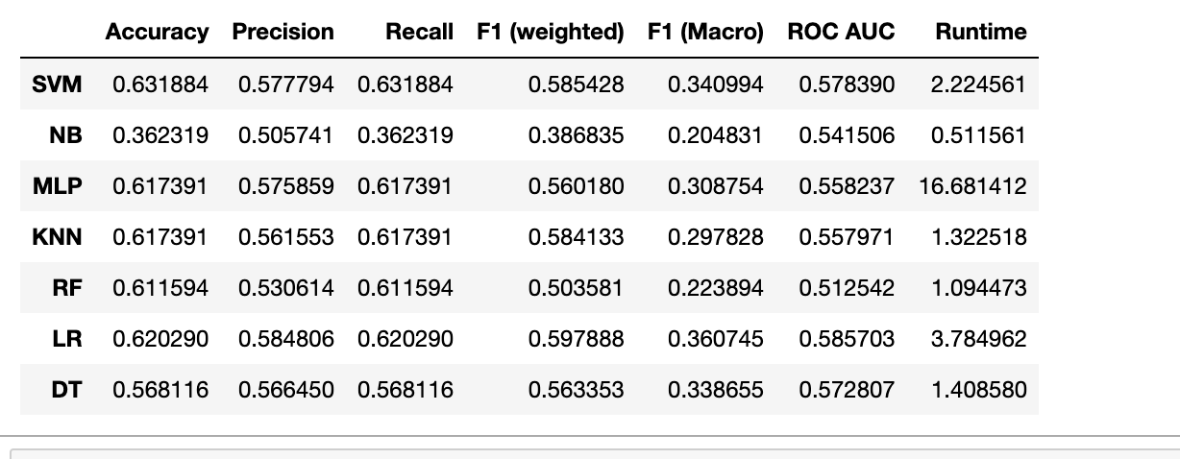
Model training results
The dataset was split using ShuffleSplit into 5 folds and each classifier was trained and evaluated for each fold.
- 30 % test size
Performance metrics : Accuracy, precision, recall, F1 score, ROC , AUC, and runtime.
Cancer Types Classification
Mutation_subtypes Classification
Notes:
Before going into the results, it is important to note our approach to dataset splitting. We applied ShuffleSplit dividing the datasets into 5 folds. Each classifer went through rigorous traing and evualtion for every fold. The test size for each fold was set at 30%
Dataset 1: 229 Samples, 16,383 Features
SVM:
Cancer Type: Accuracy 70.4%, F1 (Macro) 58.6%
Mutation Type: Accuracy 64.3%, F1 (Macro) 26.7%
Observation: SVM performs better in cancer type classification.
NB:
Cancer Type: Accuracy 40.3%, F1 (Macro) 28.3%
Mutation Type: Accuracy 46.4%, F1 (Macro) 29.3%
Observation: NB shows limited improvement in mutation type classification.
MLP:
Cancer Type: Accuracy 62.9%, F1 (Macro) 51.4%
Mutation Type: Accuracy 59.4%, F1 (Macro) 30.5%
Observation: MLP exhibits better performance in cancer type classification.
KNN:
Cancer Type: Accuracy 50.7%, F1 (Macro) 41.0%
Mutation Type: Accuracy 61.2%, F1 (Macro) 36.7%
Observation: KNN performs unexpectedly better in mutation type classification.

Slide 25
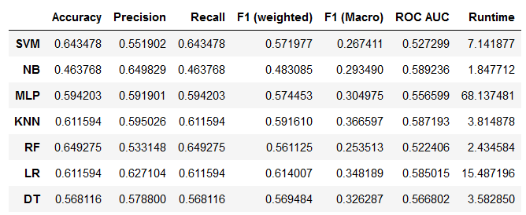
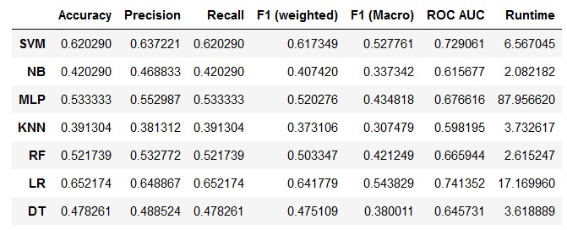
Dataset : 229 samples and 43682 features
Cancer Type Classification
Mutation Subtype Classification
Notes:
Dataset 2: 229 Samples, 43,682 Features
SVM:
Cancer Type: Accuracy 64.3%, F1 (Macro) 52.8%
Mutation Type: Accuracy 64.3%, F1 (Macro) 26.7%
Observation: SVM's performance is consistent across datasets.
NB:
Cancer Type: Accuracy 42.0%, F1 (Macro) 33.7%
Mutation Type: Accuracy 46.4%, F1 (Macro) 29.3%
Observation: NB shows consistent performance but limited improvement.
MLP:
Cancer Type: Accuracy 53.3%, F1 (Macro) 43.5%
Mutation Type: Accuracy 59.4%, F1 (Macro) 30.5%
Observation: MLP's performance is consistent, with increased runtime.
KNN:
Cancer Type: Accuracy 39.1%, F1 (Macro) 30.7%
Mutation Type: Accuracy 61.2%, F1 (Macro) 36.7%
Observation: KNN's performance is notably better in mutation type classification.

Slide 26
Observations
Both classification
Highest accuracy: SVM
longest runtime : MLP
Low performance : NB and Decision Tree (DT).
More features
Overall higher accuracy: SVM
Longest runtime: MLP
Low performance: NB and Decision Tree(DT)
Notes:
Overall Observations:
SVM maintains consistent performance across cancer type and mutation type classifications.
MLP exhibits improved performance in cancer type classification, but with a longer runtime.
KNN surprisingly performs better in mutation type classification in both datasets.

Slide 27
Performance results compared to referenced paper
Zhang YH, Huang T, Chen L, Xu Y, Hu Y, Hu LD, Cai Y, Kong X. Identifying and analyzing different cancer subtypes using RNA-seq data of blood platelets. Oncotarget. 2017 Sep 15;8(50):87494-87511. doi: 10.18632/oncotarget.
285 samples
Discarded low counts
13,445 features
SVM performance – 75 percent accuracy
Feautre selection method – mRMr
My study
SVM accuracy 70 percent accuracy without any feature selection or fine tuning
Normalized the counts
Notes:
Normalization adjusts for these differences, ensuring that the expression values are comparable across samples.
Gene Length and Composition: Longer genes tend to have more counts. Normalization corrects for this bias, allowing fair comparisons between genes of different lengths and compositions.
Statistical Assumptions: Many statistical methods used in differential expression analysis assume that the data follow a particular distribution. Normalization helps in meeting these assumptions and improves the reliability of downstream analyses.
Comparability Between Samples: Normalization ensures that expression values are on a common scale, enabling valid comparisons between samples. This is particularly important when dealing with samples from different conditions or experimental batches.
Better Detection of True Biological Variation: Normalization helps in revealing true biological differences between conditions by removing technical biases, allowing for more accurate identification of differentially expressed genes.

Slide 28
Challenges and Improvements
Challenges
Performance on the classifier NB and Decision Tree(DT) was relatively low.
Dataset complexity
Limited Sample Size
Model Complexity
SVM accuracy decreased when the dataset had more features for cancer type classificatiion.
Improvements
Performance Evalaution Strategy
Dataset Management
Algorithm Exploration
SVM Accuracy Drop
Feature Selection Technique
Notes:
Performance Variability:
NB and Decision Tree (DT): Showed relatively low performance.
Observation: Investigate specific factors impacting these classifiers, consider alternative algorithms.
Dataset Complexity:
Observation: Acknowledge the inherent complexity in the dataset, requiring robust models capable of capturing intricate patterns.
Limited Sample Size:
Observation: Recognize the challenge posed by a limited number of samples, impacting the models' ability to generalize effectively.
Model Complexity:
Observation: Reflect on potential overfitting or underfitting issues, explore model simplification or enhancement strategies.
SVM Accuracy Decrease:
Observation: Note the decrease in SVM accuracy with an increased number of features in cancer type classification, investigate reasons behind this trend.
Performance Evaluation Strategy:
Consideration: Reassess the evaluation strategy for NB and DT to identify areas for improvement.
Dataset Management:
Consideration: Evaluate the possibility of acquiring additional samples or employing data augmentation techniques to address the challenge of a limited sample size.
Algorithm Exploration:
Consideration: Explore alternative algorithms or ensemble methods that may provide better performance in the context of dataset complexity.
SVM Accuracy Drop:
Consideration: Investigate the SVM accuracy decrease with increased features—determine if this is a feature-specific issue or a broader challenge.
Feature Selection Techniques:
Implementation: Implement and experiment with various feature selection techniques to enhance model performance and interpretability.

Slide 29
Conclusion and Future Works
Cancer Type Classification Insights
Classifier Performance
Challenges Faced and Reflection
Improvements and Future Directions
Notes:
Cancer Type Classification Insights:
we explored six cancer subtypes: breast, colorectal, glioblastoma, hepatobiliary, lung, pancreatic cancer, alongside a healthy control group.
Our focus was on leveraging transcriptomic data obtained through RNA sequencing for accurate cancer classification.
The potential implications of our findings could significantly impact personalized treatment strategies.
Classifier Performance:
We observed varying levels of performance across classifiers.
Notably, SVM and LR exhibited relatively higher accuracy, emphasizing the importance of choosing suitable classifiers in different clinical contexts.
Challenges Faced:
We faced challenges, particularly with NB and DT in both cancer and mutation type classifications.
The complexity of our dataset played a role in influencing the performance of certain classifiers, raising important considerations for real-world applications.
Reflecting on Results:
Our findings contribute to advancing our understanding of cancer classification through machine learning.
Unexpected outcomes prompt us to consider their practical implications in healthcare and suggest potential areas for further investigation.
Improvements and Future Directions (8 minutes):
Feature Selection and Model Improvements:
We introduced feature selection techniques to enhance model efficiency.
The potential impact of feature selection on interpretability and performance is crucial, contributing to more practical applications in healthcare settings.
Addressing Challenges and Next Steps:
Future directions include strategies for enhanced data collection to address sample size limitations.
Continued exploration of alternative algorithms and advanced feature engineering techniques is paramount.
Interdisciplinary collaboration with experts in oncology and genomics will refine our models and align them with real-world insights.

Slide 30
Future Works
Apply reads2vec for feature selection
Advantages:
Enhance the model ability to recognize important patterns in high-dimensional genomic datasets.
Reduction of overfitting and improved interpretability by selecting relevant features.
Notes:
Applying reads2vec for Feature Selection:
Applying reads2vec offers distinct advantages for our study:
It enhances our model's ability to recognize crucial patterns within high-dimensional genomic datasets.
A key benefit is the reduction of overfitting, coupled with improved interpretability through the selection of relevant features.
Enhancing Model Performance:
By incorporating reads2vec, we aim to elevate our model's overall performance.
The focus is on selecting features that genuinely contribute to the model's predictive power, leading to enhanced accuracy and generalization.
Reducing Overfitting and Improving Interpretability:
Overfitting is a common concern in machine learning; reads2vec can help mitigate this issue.
Improved interpretability is crucial, making the model's decision-making process more transparent and actionable for clinicians.
Aligning with Practical Applications:
The use of reads2vec aligns seamlessly with practical applications in healthcare and genomics.
Its potential impact extends to personalized treatment strategies, early diagnosis, and disease prognosis.
Considerations for Implementation:
We acknowledge the need for careful implementation and validation when integrating reads2vec.
Discuss potential challenges, such as model training time or resource requirements, and emphasize the importance of thorough consideration.

Slide 31






Reference
Dobin A, Davis CA, Schlesinger F, Drenkow J, Zaleski C, Jha S, Batut P, Chaisson M, Gingeras TR. STAR: ultrafast universal RNA-seq aligner. Bioinformatics. 2013 Jan 1;29(1):15-21. doi: 10.1093/bioinformatics/bts635.
Zhang YH, Huang T, Chen L, Xu Y, Hu Y, Hu LD, Cai Y, Kong X. Identifying and analyzing different cancer subtypes using RNA-seq data of blood platelets. Oncotarget. 2017

Slide 32
Acknowledgments
Dr. Murray Patterson (GSU)
Dr. Alex Zelikovksy (GSU)
Dr. Jonathan Shihao Ji (GSU)
Sarwan Ali
Babatunde Bello

Slide 33
QUESTIONS

Slide 34
THANK YOU !

